Slide 1

CSE 163
Modules, Packages and
Processing Text Data
Hunter Schafer

Slide 2
Class
A class lets you define a new object type by specifying what state and behaviors it has
A class is a blueprint that we use to construct instances of the object
Here is a full class
class Dog:
def __init__(self, name):
self.name = name
def bark(self):
print(self.name + ': Woof')
A class definition
An initializer that sets fields (state)
A method (behavior)

Slide 3
Building Dogs
d1 = Dog('Chester')
d2 = Dog('Scout')
d3 = d1
d1.bark()
d2.bark()
d3.bark()
# Chester: Woof
# Scout: Woof
# Chester: Woof
d1
name: 'Chester'
d2
name: 'Scout'
d3

Slide 4
2 minutes
For this program, draw the memory model for the objects and then select which option best represents your model.
d1 = Dog('Chester')
d2 = Dog('Scout')
d3 = d1
p1 = DogPack()
p1.add_dog(d1)
p1.add_dog(d2)
p2 = DogPack()
p2.add_dog(d3)

Slide 5
p1
DogPack
dogs:
[ , ]
Dog
name: 'Chester'
p2
Dog
name: 'Scout'
DogPack
dogs:
[ ]

Slide 6
Private
Python has no way to actually do this, but by convention people don’t access things that start with “_”
class DogPack:
def __init__(self):
self._dogs = []
def add_dog(self, dog):
self._dogs.append(dog)
def _private_method(self):
print('Some helper method')

Slide 7
Main Method Pattern
VS Code
Why have we been making you do this annoying pattern?
If you don’t, it will run the main method if you import the file!
Usually not fun to run a 2 hour data analysis if you just wanted to import one helper function.
def main():
print('Hello world')
if __name__ == '__main__':
main()

Slide 8
Default Parameters
VS Code
You can use default parameters like you would before
You have to be careful when using objects as default values, it has some really bad unintentional side-effects
=
There is only one instance of the default parameter, they share a reference!
def fun(param=[]):
param.append(1)
print(param)
fun([2])
fun([2])
fun()
fun()
# [2, 1]
# [2, 1]
# [1]
# [1, 1]

Slide 9
Default Parameters Done Right
VS Code
The fix is to not use an object as the default parameter, instead we usually use None
def fun(param=None):
if param is None:
param = []
param.append(1)
print(param)
fun([2]) # [2, 1]
fun([2]) # [2, 1]
fun() # [1]
fun() # [1]

Slide 10
How to Run a Python Program
Python looks relative to where you are running the program
Inside main.py, I could import
If I’m inside dir, I can run things and it will look relative to where I am running the Python program
dir
├ dogs.py
└ main.py
import dogs
(/path/to/dir)$ python main.py

Slide 11
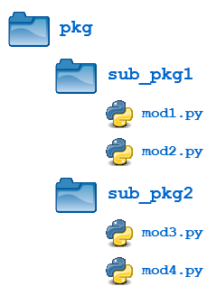
Code Organization
A module corresponds to a single Python file
It can have functions, classes, and statements inside of it
A package corresponds to a group of Python files (folder)
It can contain modules or other packages

Slide 12
How to Run a Python Program
What if I wanted to make a pets package
We have to change how we import it now
Running the program is the same though
dir
├ main.py
└ pets
└ dogs.py
import dogs
import pets.dogs
(/path/to/dir)$ python main.py

Slide 13
__init__.py
By default, Python usually doesn’t convert folders to packages
You need to put a special file named __init__.py in the folder to make it a package
This file can be empty
You don’t need one in your top-level directory, because you are not going to import it!
dir
├ main.py
└ pets
├ __init__.py
└ dogs.py

Slide 14
Brain Break

Slide 15
Unstructured Text
So far we have seen “structured” text. Has nice orderly format.
Most text in the world is unstructured (free-form)
Books, Wikipedia, Tweets
The techniques we need to process this data are pretty different
Today’s data: Wikipedia articles about people

Slide 16
Representation
Matters
When working with natural language, we use different representations of the data to compute different properties
In this class, we will see
Bag of Words
TF-IDF
Unigram
Bi-gram
Today we are just talking about Bag of Words
Goal: Identify similarity between two documents

Slide 17
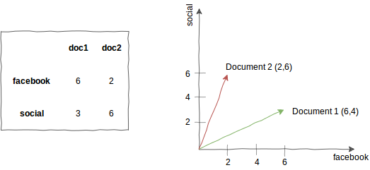
Bag of Words
Very simple representation
Make a dictionary that maps words to their counts
We use this to think of each document like a vector
Really just a point in space
There is one dimension for each word. This is HUGE.

Slide 18
Dimensions
Technically, we would need to have an entry for every possible word in the language so we could compare the vectors.
We will use a sparse representation
Each document will only store keys that it has counts for
Any missing keys are considered 0.
This saves a lot of space for each document, but the dimensionality of these things is still really big.

Slide 19
Distance
Now that each document is a vector that lives in a space, we can actually talk about the “distance” between one document and another
The “distance” between 2 documents is the distance between their vectors
distance

Slide 20
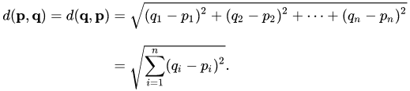
Euclidean Distance
VS Code
You may have seen this before in a math class
The euclidean distance between two vectors p and q
This is just a random formula from linear algebra, don’t memorize it.

Slide 21
Euclidean Distance + NLP
Euclidean distance does not really work with these bag of words
It cares too much about the magnitudes of the vectors
This causes weird effects based on the length of the documents
What we care about is that the documents use similar sets of words rather than penalizing differences in counts
𝜽

Slide 22
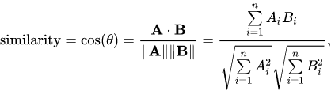
Cosine Distance
Instead, measure the angle between the vectors
Use cosine-similarity find how similar they are
Just a random formula from linear algebra, don’t memorize this
This is a measure of similarity, so to get distance we take 1 - similarity

